Slide 1
Monqez
Supervised by
Dr. Mohamed El-Ramly, TA. Sarah El-Nady
Hussien Ashraf Abdul-Hamid | 20170093
Ehab Fawzy Ibrahim | 20170072
Hatem Mamdoh Saed | 20170085
Khaled Ezzat Ahmed | 20170098
Graduation Project Academic Year 2020-2021 Midyear Presentation

Slide 2
01
Introduction

Slide 3
Background
Several people die when involved in an accident because of the absence of first aid in crucial time.
Monqez is a mobile application that, among other features, allows a video or voice call with a qualified paramedic or requests a nearby specialist to help onsite and provide the needed first aid.
The project’s domain is software engineering.

Slide 4
Problem Definition
Accidents occur every day all around the world.
93% of people will call for an ambulance if they find someone in need but ambulance may arrive late.
How can we help people who just witnessed an accident save victim’s life?
A fast and easy method is needed to connect people with paramedics at emergencies either onsite or via voice or video call.

Slide 5

Motivation

Slide 6
01
150,000 deaths a year could have been saved if the right first aid was applied.
02
59% of deaths that occurred before arriving to the hospital could have been saved.

Slide 7
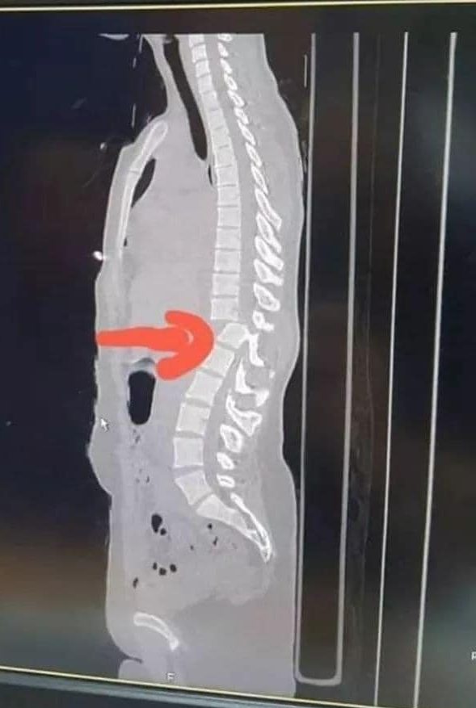
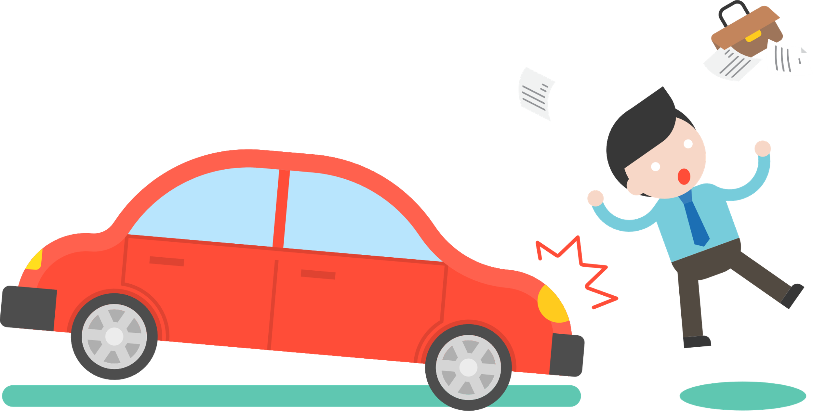
03
A 27-year-old girl had an accident. Everyone around got the girl to sit on a chair. This simple action resulted in cut in the spinal cord as the attached picture shows making this girl paralyzed for the rest of her life.

Slide 8
Proposed Solution
A mobile application is being developed to provide help to people in need of medical assistance until an ambulance arrives.
The application connects the user requesting help to the nearest available paramedic.
The application provides basic first aid tips either through pictures or videos.
All registered paramedics must be certified and need to have passed a first aid course from accredited institutions.

Slide 9

02
Related Works

Slide 10
New Zealand Red Cross First Aid
Web application that provides courses and step by step instructions for a variety of emergencies.
Doesn’t send a paramedic to help the victim.
It relies on normal users to understand and follow the first aid instructions shown

Slide 11
PulsePoint Respond
Informs users of emergencies in their community and can request their help when CPR is needed nearby.
Mostly concentrates on cardiac attack.
People sent to help victims aren’t necessarily paramedics.
No voice or video call are provided.

Slide 12
Asifny
Asifny sends a distress call by SMS service to Saudi Red Crescent Authority and relatives.
This application sends an ambulance - not a nearby person with a first aid certificate - to the patient in order to save his life.
This makes the process of reaching the patient slower.

Slide 13

03
Project Specification

Slide 14
Functional Requirements
Show the first aid instructions for any type of injury.
Allow the normal user to request a Monqez for himself or for someone else in need of first aid.
Connect the normal user to a Monqez so that the Monqez shall arrive to the emergency site.
Provide video and voice calls between a normal user and any available Monqez.
Allow normal users to add friends and family members in order to quicken the process of requesting a Monqez in case of an emergency.
Show the Monqez applications and their certificates to administrators.

Slide 15

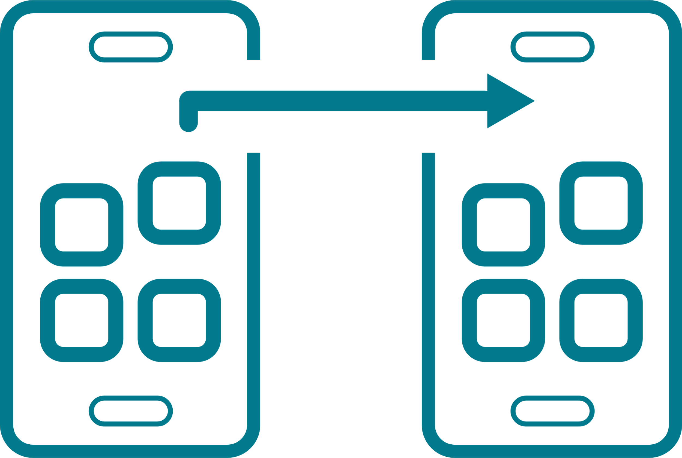



Non-functional Requirements
Performance
Portability
Reliability
Minimal searching time for nearby Monqez.
Application works on different OS.
Work with full functionality in worst cases.
Usability
Robustness
Application is very easy to use (user-friendly).
Application handles invalid user input.

Slide 16
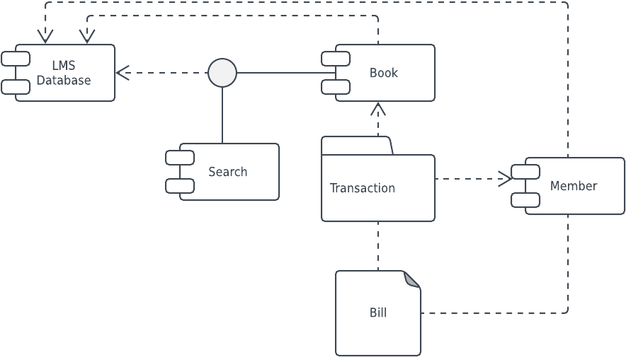
04
System Design

Slide 17
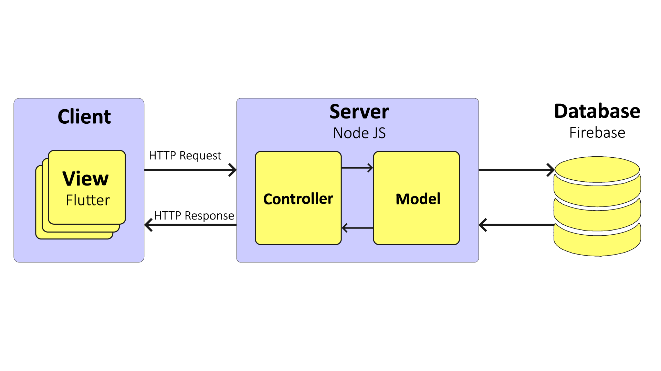
System Architecture

Slide 18
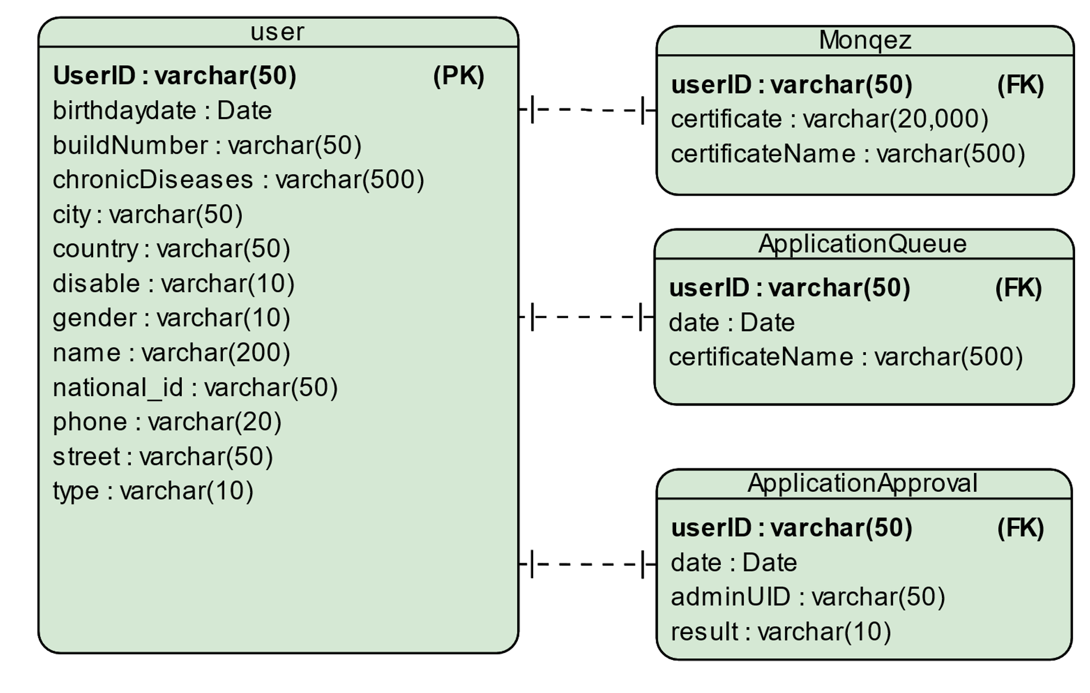
Entity Relationship Diagram (ERD)

Slide 19
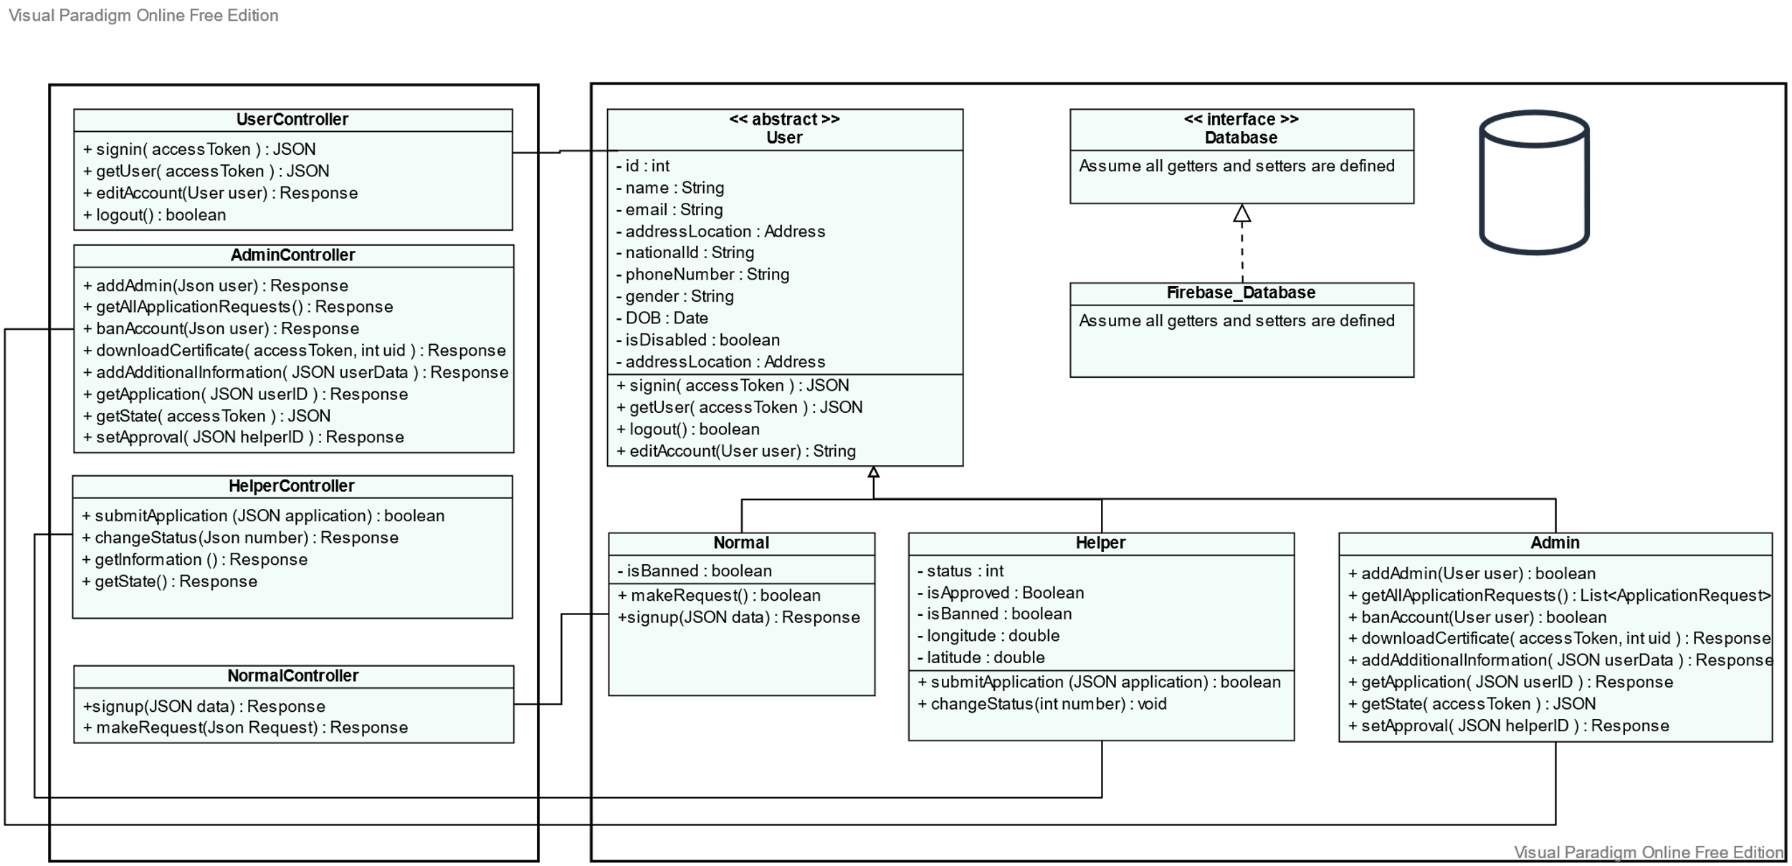
Class Diagram
Assume all models calling Firebase_Database

Slide 20
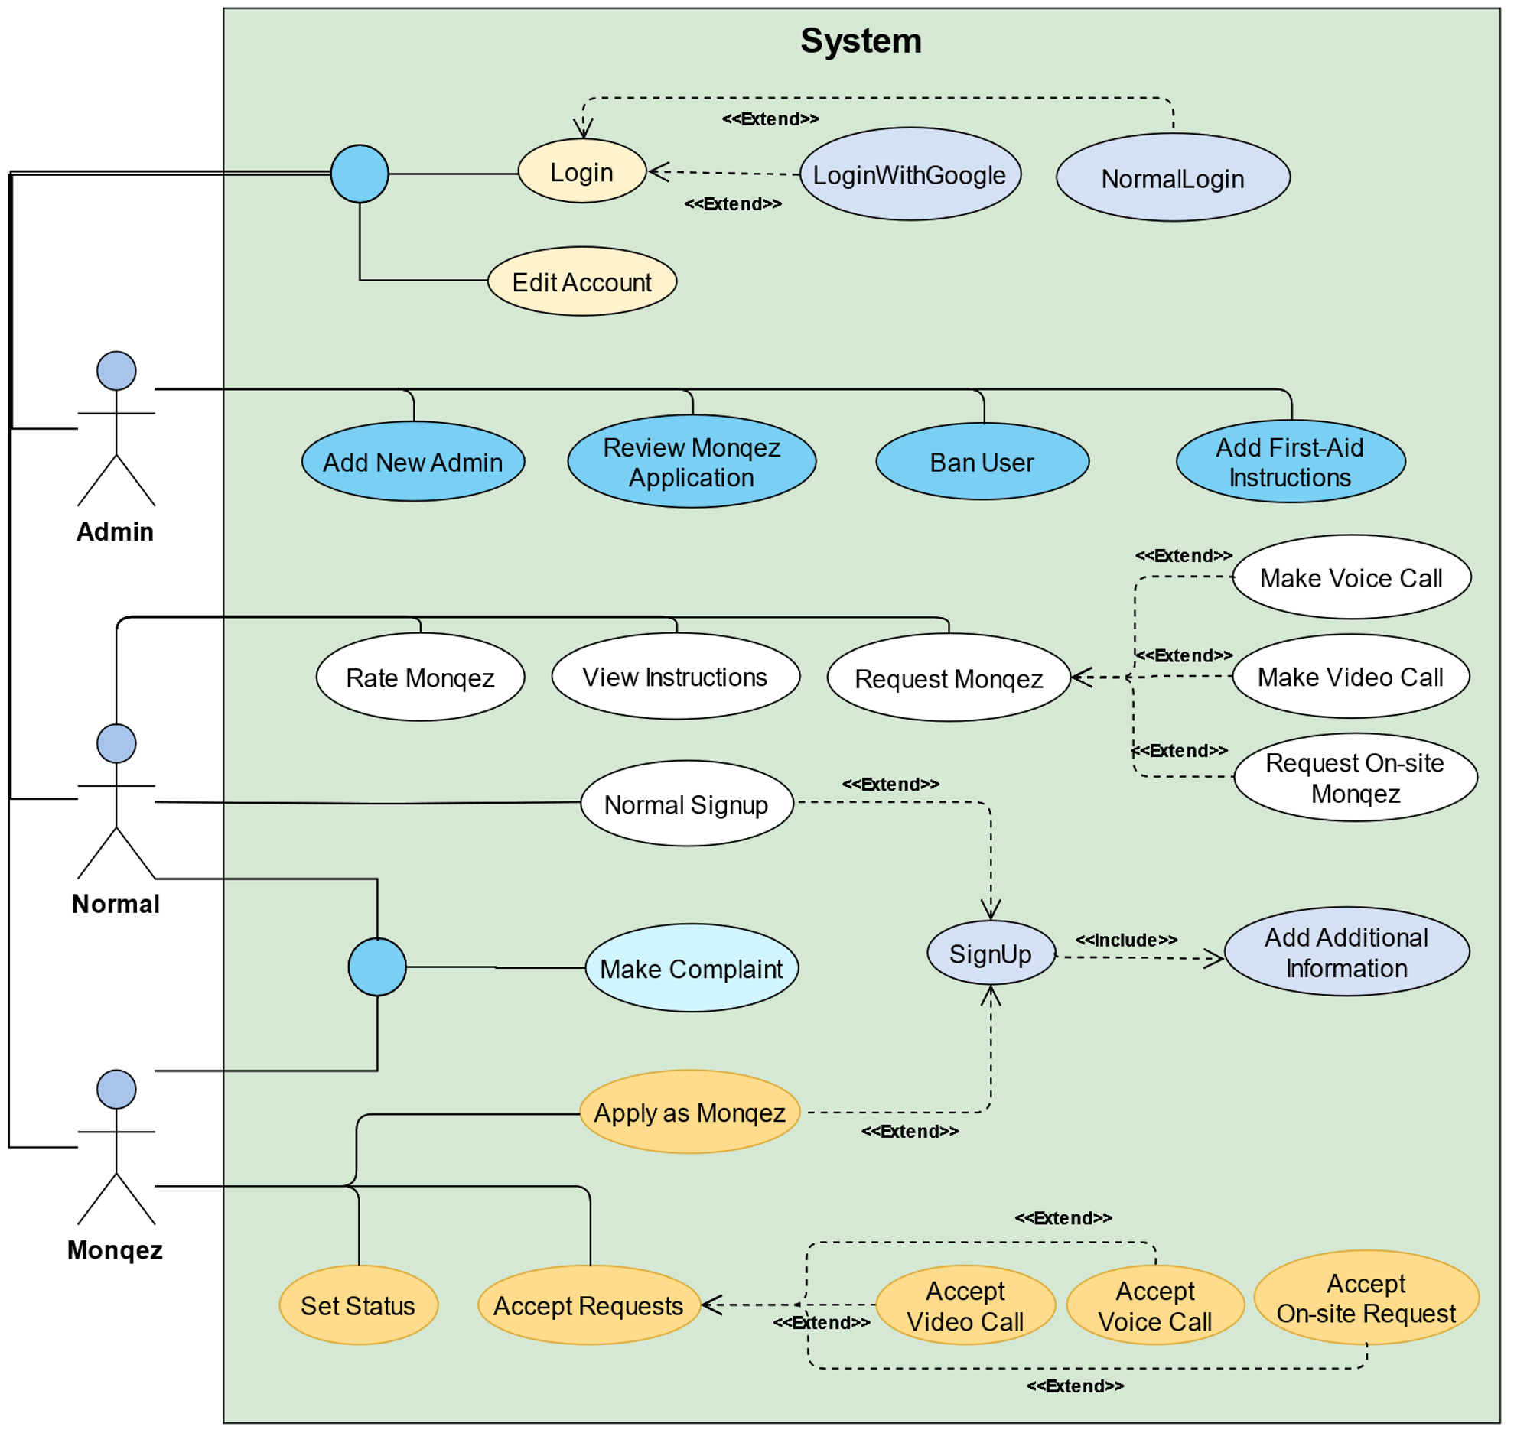
Use case Diagram

Slide 21
Sample Use Case
Use Case Name | Signup.
Brief Description | User creates a new account in the system.
Actors | Normal user, Helper (Monqez).
Preconditions | No account exists for the user in the database.
Postconditions | A new account is added to the database with the user information.
Main Scenario | System displays the signup page. User enters the credentials (email and password). System stores the credentials. System redirects the user to the “Add Additional Information” page.
Exception Flow | System displays an error message. System displays the signup page.

Slide 22
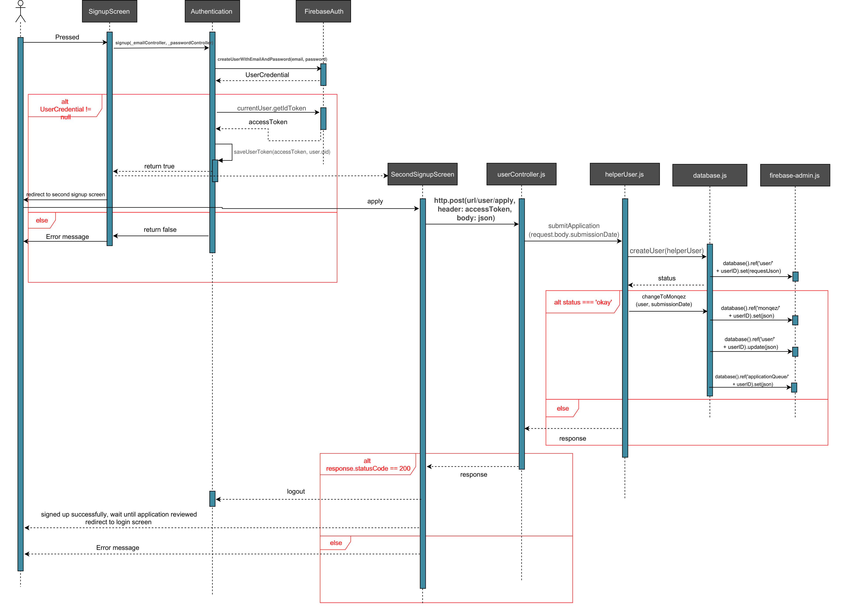
Sequence Diagram
Apply as Monqez

Slide 23
05
Gantt Chart

Slide 24
October
November
December
January
Sprint 1
Brainstorming
SRS
Sprint 2
Sign in
Sign up
Sprint 3
Normal User Home Screen
Admin User Home Screen
Sprint 4
Helper User Home Screen

Slide 25
January
February
March
April
Sprint 5
Documentation
Deploy server on Heroku
Sprint 6
Finish Monqez Request
Sprint 7
Voice Calls
Video Calls
Sprint 8
Finalize The Project

Slide 26
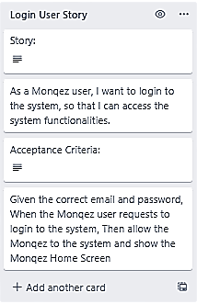
User Story Sample

Slide 27
Conclusion
Monqez is expected to decrease the number of fatalities that occur before ambulances arrive.
It helps save lives by providing the appropriate first aid to the person in need of medical assistance in timely matter.
Its support to voice and video call will ensure that anyone near the victim can help him as much as possible until a paramedic arrives.
It will notify its users whenever they are in an accident-prone zone using machine learning so that they would be careful.
With minor modifications, the scope of Monqez can be completely changed.

Slide 28

Monqez Demo

Slide 29
Monqez Demo

Slide 30
Thanks
Questions?

Slide 31
References
The Guardian. 2021. Lack of first aid skills endangers up to 150,000 lives.
University of Manchester. 2016. Over half of deaths from injury.
Redcross.org.nz. 2021. First aid courses | New Zealand Red Cross.
PulsePoint Respond.
Asifny (Google Play).
[Link]
[Link]
[Link]
[Link]
[Link]

